Slide 1

Team Name: FlexiFusion
Theme: One less thing , one more purpose
Project Title: PROTECTOTE
S.No | Name of the student | Year/Dept. | Email Id | Contact Number
1 | Akalya B | 2nd/ECE | akalyahas1877@gmail.com | 7010572747
2 | Abitha K R | 2nd/ECE | akr77852@gmail.com | 6380615493
3 | Gayathri K K | 2nd/ECE | gayathrikanaga29@gmail.com | 7418711329
College Name: K Ramakrishnan College Of Technology
Team Leader Name : Akalya B

Slide 2
Problem Statement
To develop a versatile accessory that functions both as an umbrella and a handbag, addressing the needs of users who require both items during the summer months and rainy seasons . The solution should seamlessly transition between these two functions while maintaining practicality, aesthetics, and ease of use.
The accessory should serve as a fully functional umbrella for sun protection and a practical handbag for carrying personal items.

Slide 3

REAL TIME PROBLEM

Slide 4
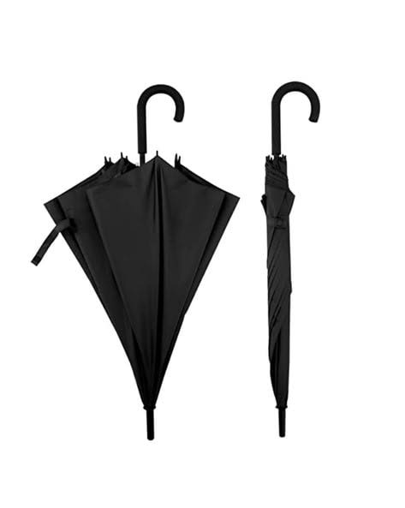
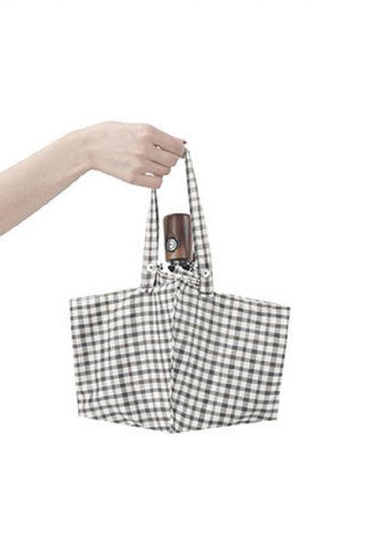

EXISTING PRODUCT DETAILS

Slide 5
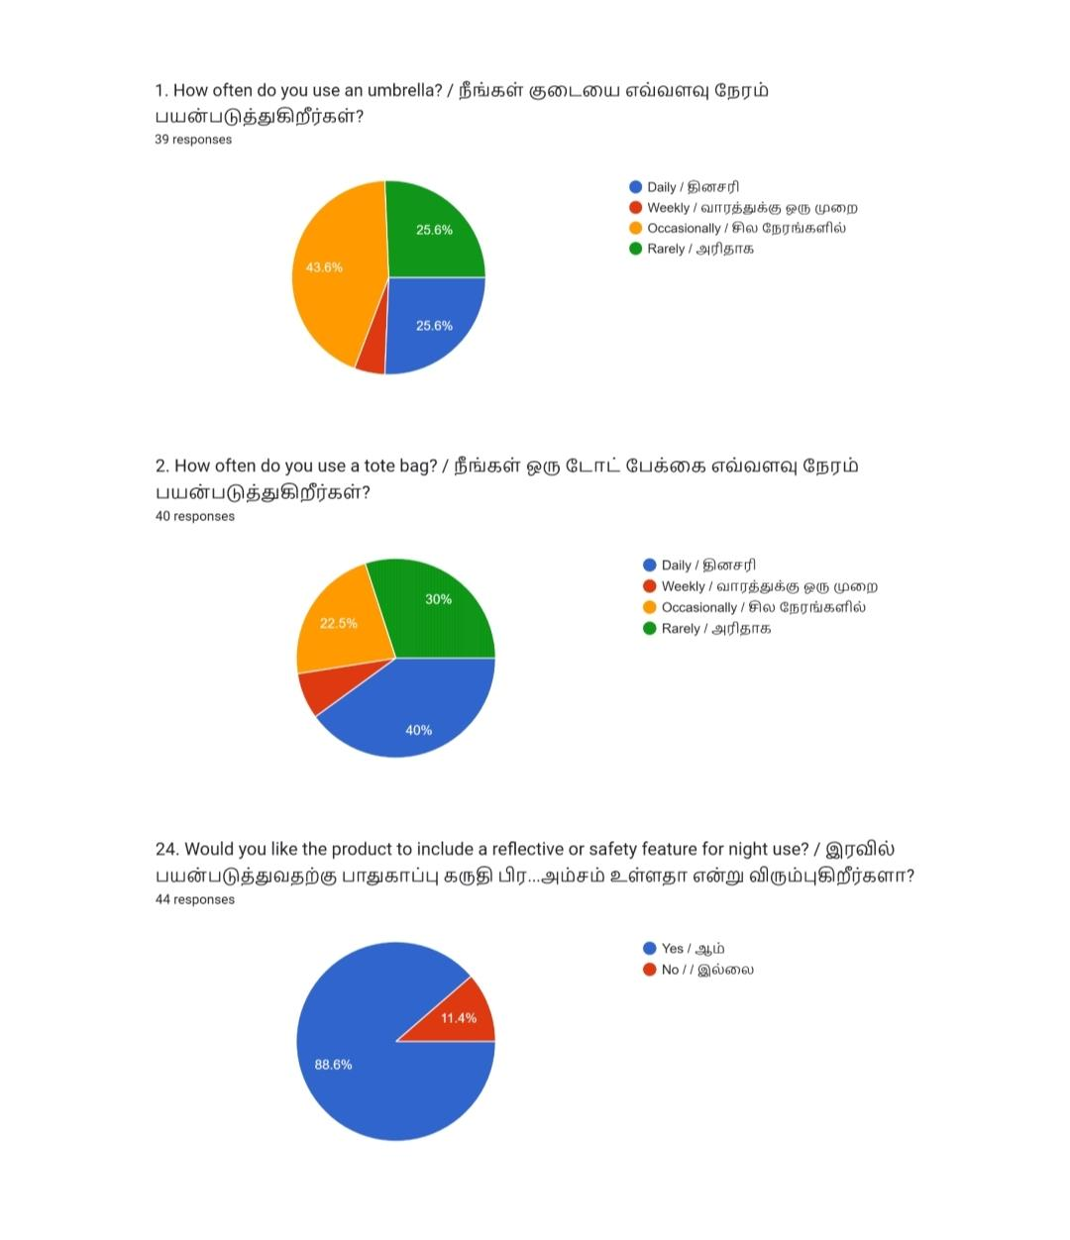
HIGHLIGHTED SURVEY REPORT

Slide 6
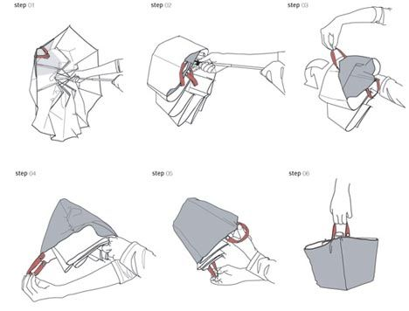
SOLUTION ON PROPOSED DESIGN

Slide 7
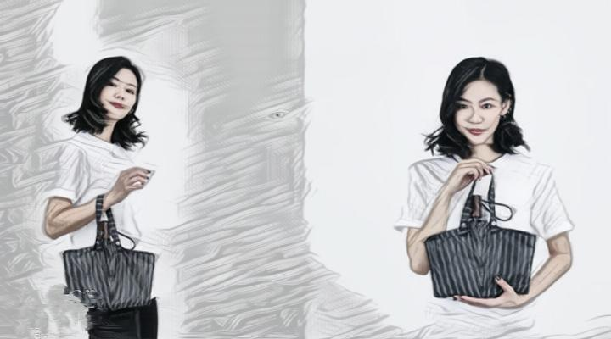
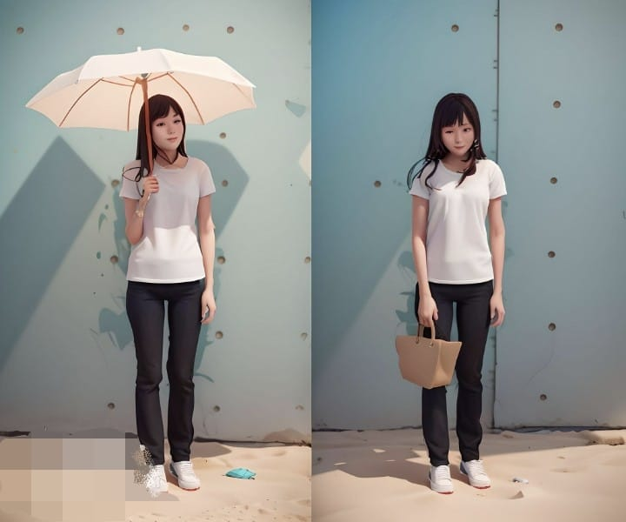
WORKING OF INVENTION

Slide 8
TARGET MARKETING
Travelers
Students
Urban commuters
Eco conscious consumers
Office spaces

Slide 9
COMPETITOR ANALYSIS
Alternate Solutions
Telescopic Handle with Storage bag
Detachable umbrella bag system
My Solution Product
Protectote (multifunctional product ,both bag and Umbrella are using)

Slide 10
VALUE PROPOSITION
Combines an umbrella and a tote bag, reducing the need for multiple accessories.
Lightweight and compact design makes it easy to carry and use daily.
Modern and fashionable, catering to urban and style-conscious users.
Made from weather-resistant, high-quality materials for long-lasting use.
Additional compartments in bag mode for better organization of personal items.
Crafted from sustainable materials, appealing to environmentally conscious consumer

Slide 11
CHANNELS FOR MARKETING
Company Website Social Media Marketing Influencer Marketing Email Marketing
Content Marketing Online Advertising Retail Partnerships Customer Referral Program Trade Shows and Exhibitions

Slide 12
REVENUE MODEL
Direct Sales
Wholesale Distribution
Bundling with Other Products
Customization and Personalization
Online Advertising and Affiliate Marketing
Product Licensing and Distribution
Corporate Sales and B2B Contracts
E-commerce Marketplace

Slide 13
MARKETING STRATEGY
1.Market Analysis
Understand target audience preferences, behavior, and purchasing patterns in different industries such as households, office spaces, and hospitality.
2.SWOT Analysis:
Strengths: Durability, smooth movement, and modern aesthetics. Weaknesses: Potential higher cost compared to plastic alternatives.
Threats: Competition from low-cost, traditional furniture accessories.

Slide 14
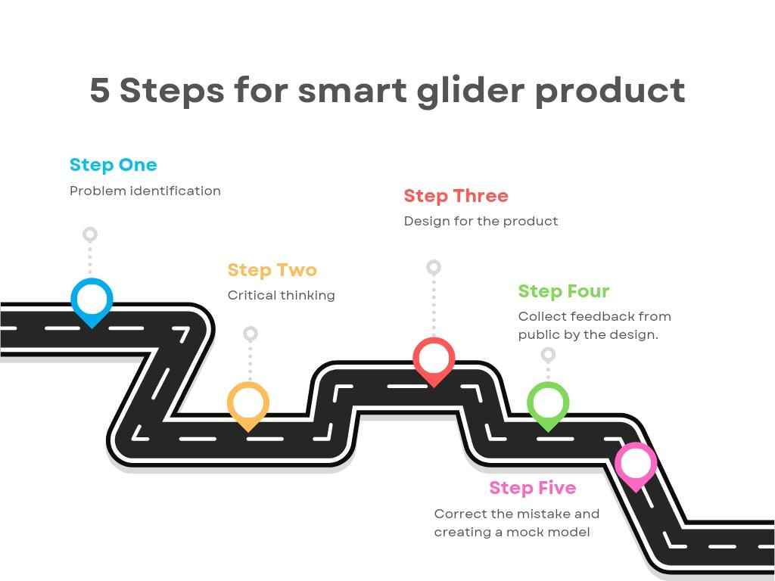
ROAD MAP

Slide 15


